Slide 1
Designing Test Benches in VERILOG

Slide 2
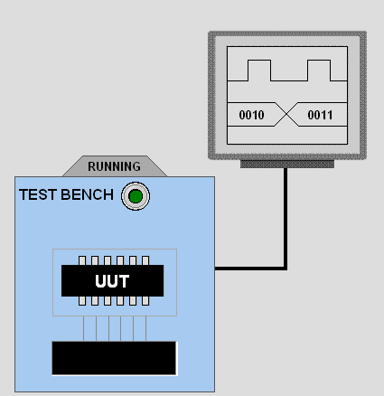
Test Bench
module main;
reg a, b, c;
wire sum, carry;
fulladder add(a,b,c,sum,carry);
initial
begin
a = 0; b = 0; c = 0;
#5
a = 0; b = 1; c = 0;
#5
a = 1; b = 0; c = 1;
#5
a = 1; b = 1; c = 1;
#5
end
endmodule

Slide 3
Designing Your Testbench
You can make your testbench as simple or as complex as you want.
A complex testbench would perform response verifivation “on-the-fly”.
simple testbench
control
design
sophisticated testbench
control
observe
design

Slide 4
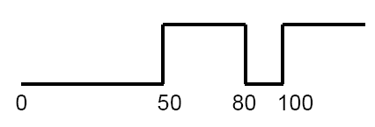
Test Bench - Generating Stimulus
Example: A sequence of values
  initial begin
  Clock = 0;
  #50 Clock = 1;
  #30 Clock = 0;
  #20 Clock = 1;
  end

Slide 5
Writing Testbenches
module test;
reg a, b, sel;
mux m(y, a, b, sel);
initial
begin
$monitor (a, b, sel, y);
sel = 0;
#10 a = 0; b= 0;
#10 a = 0; b= 1;
#10 a = 1; b= 0;
#10 a = 1; b= 1;
sel = 1;
#10 a = 0; b= 0;
#10 a = 0; b= 1;
#10 a = 1; b= 0;
#10 a = 1; b= 1;
end
Inputs to device under test
Device under test
$monitor is a built-in event driven “printf”
Stimulus generated by sequence of assignments and delays

Slide 6
Creating Clocks
reg clk;
always begin
#10 clk = 0;
#10 clk = 1;
end

Slide 7
Stimulus From Loops
Stimulus applied from a loop has the following characteristics:
For each iteration you assign a new stimulus vector
The timing relationships between signals are regular in nature
The testbench is compact
module loop_tb;
wire [7:0] response;
reg [7:0] stimulus;
reg clk;
integer i;
DUT u1 (response,stimulus);
inititial clk = 0;
always begin
#10 clk = 1;
#10 clk = 0;
end
initial begin
for (i = 0;i <= 100 ;i=i + 1）
#10 stimulus = stimulus +1 ;
#20 $finish;
end
endmodule

Slide 8
Write the Test Bench for 4-to-1 Multiplexer
s
0
s
1
s
1
s
0
f
w
0
00
0
0
w
0
w
1
01
f
0
1
w
1
w
2
10
1
0
w
w
3
11
w
2
1
1
3
(a) Graphic symbol
(b) Truth table
s
0
w
0
s
1
w
1
f
w
2
w
3
(c) Circuit

Slide 9
Write the Test Bench for Full adder
x
sum
y
Full Adder
cout
cin

Slide 10
Write the Test Bench for 2-to-4 Decoder
En
w
1
w
0
y
3
y
2
y
1
y
0
w
1
y
3
1
0
0
0
0
0
1
w
y
1
0
1
0
0
1
0
0
2
1
1
0
0
1
0
0
y
1
1
1
1
1
0
0
0
En
y
0
0
-
-
0
0
0
0
(a) Truth table
(b) Graphical symbol
w
0
y
0
w
1
y
1
y
2
y
3
En
(c) Logic circuit

Slide 11
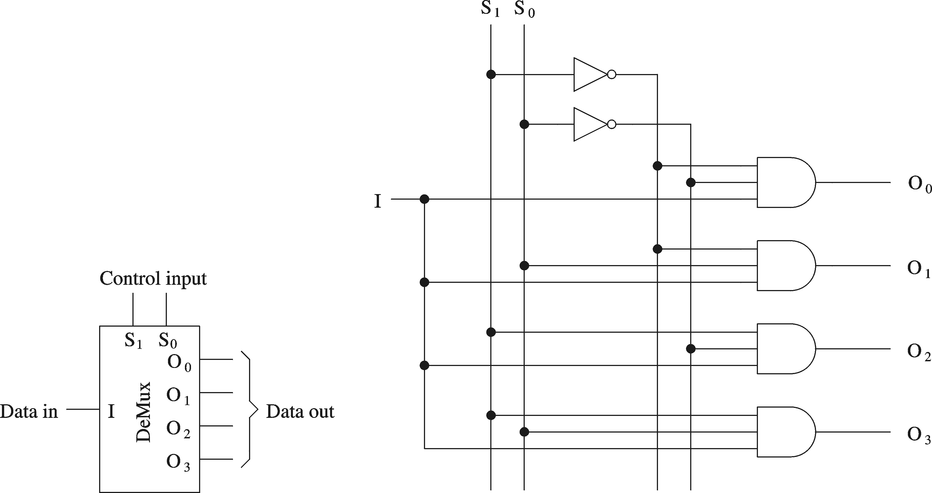
Write the Test Bench for 1-to-4 Demultiplexer

Slide 12
Write the Test Bench for Counter with clock selector
reset
Clk0
Clk1
mux
counter
count
Clk2
Clk3
cs1
cs0

Slide 13
Procedure For Simulating Verilog Files
1. Type the verilog program in a text editor.
2. save the program in the "bin" folder of the "iverilog".
3. open command prompt window(Run --> cmd)
4. Change the directory to "C:\iverilog\bin“
5. For compiling => Type "C:\iverilog\bin\iverilog -o h myfile.v
6. Then Type "C:\iverilog\bin\vvp h“
7. To See the output in Graphical form Type "gtkwave myfile.vcd”

